Slide 1
HTML basics
Dr. Mark Junjie Li

Slide 2
What is HTML?
HTML:
The set of markup symbols or codes placed in a file intended for display on a Web browser page.
The World Wide Web Consortium (http://w3c.org) sets the standards for HTML and its related languages.

Slide 3
HTML Elements
Each markup code represents an HTML element .
Each element has a purpose.
Most elements are coded as a pair of tags:
an opening tag and a closing tag.
Tags are enclosed in angle brackets, "<" and ">" symbols.

Slide 4
What is XHTML?
The most recent standard version of HTML
eXtensible HyperText Markup Language.
XHTML uses:
  the elements and attributes of HTML
  the syntax of XML (eXtensible Markup Language).

Slide 5
XML Syntax
An XML document must be well-formed.
  Use lowercase
  Use opening and closing tags
  <body> </body>
  Close stand-alone tag with special syntax
  <hr />

Slide 6

What is HTML5 ?
Newest draft version of HTML/XHTML
Supported by modern browsers
  Safari, Google Chrome, Firefox, Internet Explorer 9
Intended to be backwards compatible
Adds new elements
Adds new functionality
  Edit form data
  Native video and audio
  And more!

Slide 7
Document Type Definition
Document Type Definition (DTD)
  doctype statement
  identifies the version of HTML contained in your document.
  placed at the top of a web page document

Slide 8
DTD Examples
XHTML 1.0 Transitional DTD
<!DOCTYPE html PUBLIC "-//W3C//DTD XHTML 1.0 Transitional//EN"
http://www.w3.org/TR/xhtml1/DTD/xhtml1-transitional.dtd>
HTML5 DTD
<!DOCTYPE html>

Slide 9
EXAMPLE XHTML WEB PAGE
<!DOCTYPE html PUBLIC "-//W3C//DTD XHTML 1.0 Transitional//EN"
"http://www.w3.org/TR/xhtml1/DTD/xhtml1-transitional.dtd">
<html xmlns="http://www.w3.org/1999/xhtml" lang="en" xml:lang="en">
<head>
<title>Page Title Goes Here</title>
<meta http-equiv="Content-Type" content="text/html; charset=utf-8" />
</head>
<body>
... body text and more XHTML tags go here ...
</body>
</html>

Slide 10
EXAMPLE HTML5 WEB PAGE
<!DOCTYPE html>
<html lang="en">
<head>
<title>Page Title Goes Here</title>
<meta charset="utf-8">
</head>
<body>
... body text and more HTML5 tags go here ...
</body>
</html>

Slide 11
Head & Body Sections
Head Section
Contains information that describes the Web page document
  <head>
  …head section info goes here
  </head>
Body Section
Contains text and elements that display in the Web page document
<body>
  …body section info goes here
  </body>

Slide 12
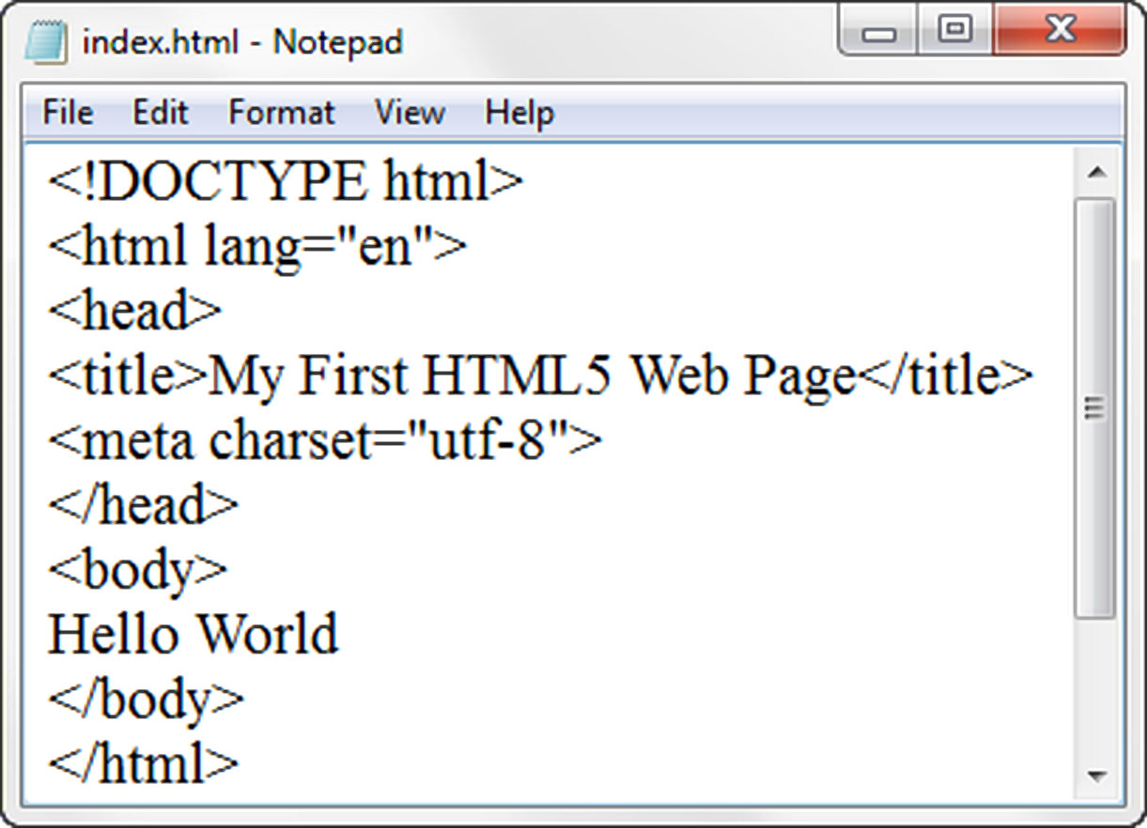
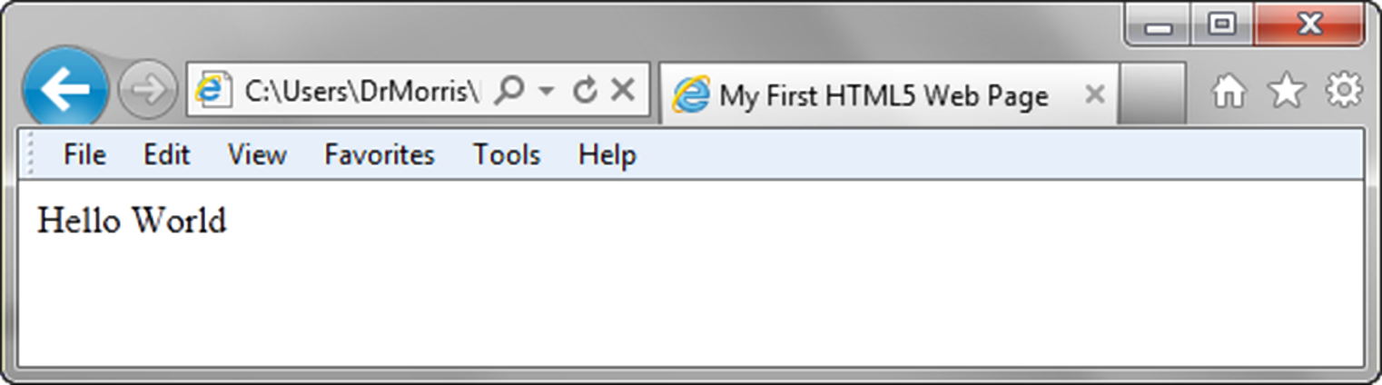
Title Element
Meta Element

Slide 13
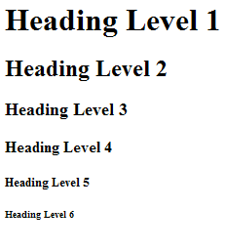
The Heading Element
<h1>Heading Level 1</h1>
<h2>Heading Level 2</h2>
<h3>Heading Level 3</h3>
<h4>Heading Level 4</h4>
<h5>Heading Level 5</h5>
<h6>Heading Level 6</h6>

Slide 14
Paragraph Element
Paragraph element
<p> …paragraph goes here… </p>
  Groups sentences and sections of text together.
  Configures a blank line above and below the paragraph

Slide 15
Line Break Element
Line Break element
  Stand-alone, or void tag
    XHTML syntax: <br />
    HTML syntax: <br>
  …text goes here <br>
  This starts on a new line….
  Causes the next element or text to display on a new line

Slide 16
Blockquote Element
Blockquote element
  Indents a block of text for special emphasis
  <blockquote>
  …text goes here…
  </blockquote>

Slide 17
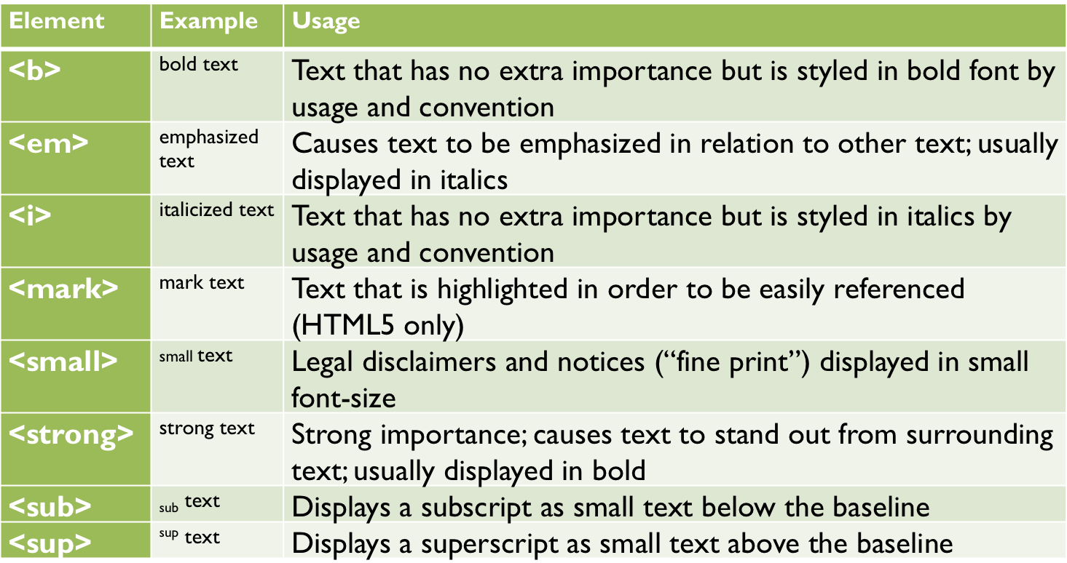
Phrase Elements
Indicate the context and meaning of the text

Slide 18
HTML Lists
Unordered List
Ordered List
Description List
formerly called a definition list

Slide 19
Unordered List
Displays a bullet, or list marker, before each entry in the list.
<ul>
Contains the unordered list
  type attribute determines the type of bullet point
  default type is disc (but depends on the browser)
<li>
Contains an item in the list

Slide 20
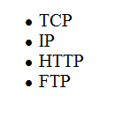
Unordered List Example
<ul>
<li>TCP</li>
<li>IP</li>
<li>HTTP</li>
<li>FTP</li>
</ul>

Slide 21
Ordered List
Displays a numbering or lettering system to itemize the information contained in the list
<ol>
Contains the ordered list
  type attribute determines numbering scheme of list, default is numerals
<li>
Contains an item in the list

Slide 22
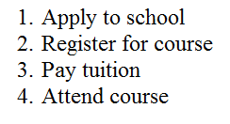
Ordered List Example
<ol>
<li>Apply to school</li>
<li>Register for course</li>
<li>Pay tuition</li>
<li>Attend course</li>
</ol>

Slide 23
Description List
Useful to display a list of terms and descriptions or a list of FAQ and answers
  <dl>
  Contains the description list
  <dt>
  Contains a term/phrase/sentence
  Configures empty space above and below the text
  <dd>
  Contains a description of the term/phrase/sentence
    Indents the text
    Configures empty space above and below the text

Slide 24
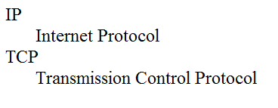
Description List Example
<dl>
<dt>IP</dt>
<dd>Internet Protocol</dd>
<dt>TCP</dt>
<dd>Transmission Control Protocol</dd>
</dl>

Slide 25
Special Characters
Display special characters such as quotes, copyright symbol, etc.
Character Code
© &copy;
< &lt;
> &gt;
& &amp;
&nbsp;

Slide 26
Div Element
Configures a structural block area or “division” on a web page with empty space above and below.
Can contain other block display elements, including other div elements
<div>Home Services Contact</div>

Slide 27
Anchor Element
Specifies a hyperlink reference (href) to a file
Text between the <a> and </a> is displayed on the web page.
<a href="contact.html">Contact Us</a>
href Attribute
  Indicates the file name or URL

Slide 28
Absolute & Relative Hyperlinks
Absolute link
  Link to other websites
<a href="http://yahoo.com">Yahoo</a>
Relative link
  Link to pages on your own site
<a href="index.htm">Home</a>

Slide 29
E-Mail Hyperlink
Automatically launch the default mail program configured for the browser
If no browser default is configured, a message is displayed
<a href=“mailto:me@hotmail.com”>me@hotmail.com</a>

Slide 30
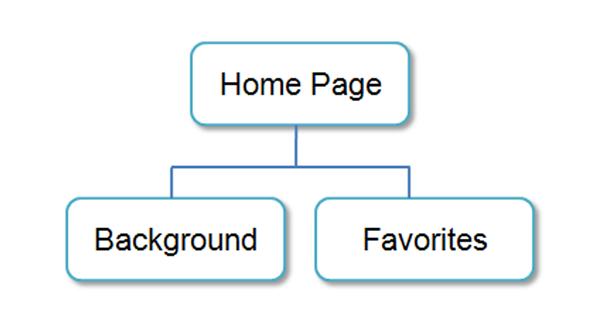
Hyperlinks
Hands-On Practice

Slide 31
Writing Valid XHTML
Check your code for syntax errors
  Benefit:
    Valid code →
    more consistent browser display
W3C XHTML Validation Tool
  http://validator.w3.org

Slide 32
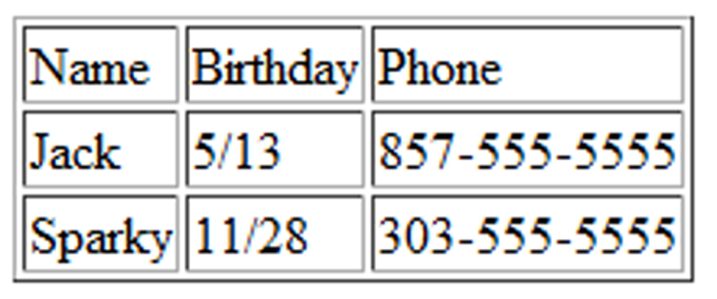
HTML Table
Tables are used on web pages
to organize tabular information
Composed of rows and columns – similar to a spreadsheet.
Each individual table cell is at the intersection of a specific row and column.
Configured with table, tr, and td elements

Slide 33
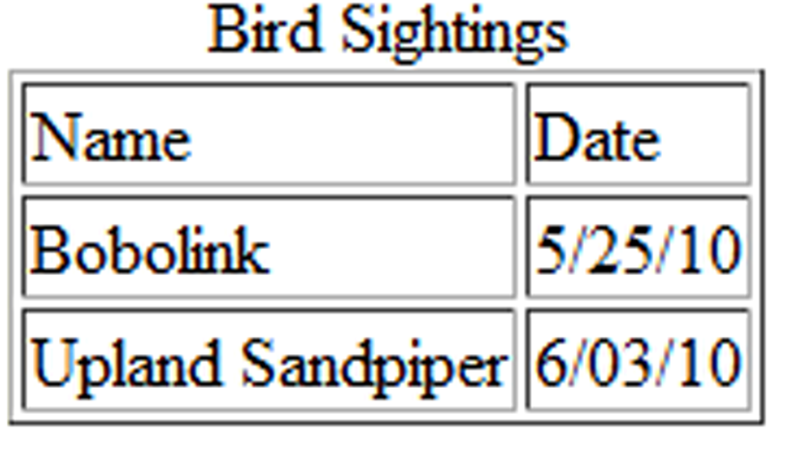
HTML Table Elements
<table>
Contains the table
<tr>
Contains a table row
<td>
Contains a table cell
<caption>
Configures a description of the table

Slide 34

HTML
Table Example
<table border="1">
<caption>Bird Sightings</caption>
<tr>
<td>Name</td>
<td>Date</td>
</tr>
<tr>
<td>Bobolink</td>
<td>5/25/10</td>
</tr>
<tr>
<td>Upland Sandpiper</td>
<td>6/03/10</td>
</tr>
</table>

Slide 35
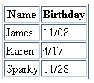
HTML
Table Example 2
<table border="1">
<tr>
<th>Name</th>
<th>Birthday</th>
</tr>
<tr>
<td>James</td>
<td>11/08</td>
</tr>
<tr>
<td>Karen</td>
<td>4/17</td>
</tr>
<tr>
<td>Sparky</td>
<td>11/28</td>
</tr>
</table>
Using the <th> Element

Slide 36
HTML Common Table Attributes
align (obsolete)
bgcolor (obsolete)
border (obsolete)
cellpadding (obsolete)
cellspacing (obsolete)
summary (obsolete but may be reinstated)
width (obsolete)
Use CSS to configure table characteristics instead of HTML attributes

Slide 37
HTML Common Table Cell Attributes
align (obsolete)
bgcolor (obsolete)
colspan
rowspan
valign
height (deprecated)
width (deprecated)
Use CSS to configure most table cell characteristics instead of HTML attributes

Slide 38

HTML colspan Attribute
<table border="1">
<tr>
<td colspan=“2”>
Birthday List</td>
</tr>
<tr>
<td>James</td>
<td>11/08</td>
</tr>
<tr>
<td>Karen</td>
<td>4/17</td>
</tr>
</table>

Slide 39
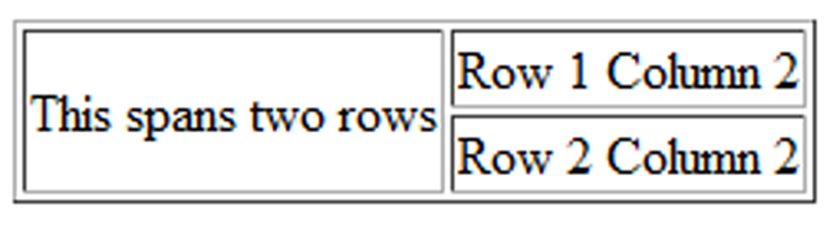
HTML rowspan Attribute
<table border="1">
<tr>
<td rowspan="2">This spans two rows</td>
<td>Row 1 Column 2</td>
</tr>
<tr>
<td>Row 2 Column 2</td>
</tr>
</table>

Slide 40
Accessibility and Tables
Use table header elements (<th> tags) to indicate column or row headings.
Use the caption element to provide a text title or caption for the table.
Complex tables:
Associate table cell values with their corresponding headers
  <th> tag id attribute
  <td> tag headers attribute

Slide 41
<table border="1">
<caption>Bird Sightings</caption>
<tr>
<th id="name">Name</th>
<th id="date">Date</th>
</tr>
<tr>
<td headers="name">Bobolink</td>
<td headers="date">5/25/10</td>
</tr>
<tr>
<td headers="name">Upland Sandpiper</td>
<td headers="date">6/03/10</td>
</tr>
</table>

Slide 42
Using CSS to Style a Table
HTML Attribute | CSS Property
align | Align a table: table { width: 75%; margin: auto; } Align within a table cell: text-align
bgcolor | background-color
cellpadding | padding
cellspacing | border-spacing or border-collapse
height | height
valign | vertical-align
width | width
border | border, border-style, or border-spacing
-- | background-image

Slide 43
CSS Structural Pseudo-classes
Pseudo-class | Purpose
:first-of-type | Applies to the first element of the specified type
:first-child | Applies to the first child of an element (CSS2 selector)
:last-of-type | Applies to the last element of the specified type
:last-child | Applies to the last child of an element
:nth-of-type(n) | Applies to the “nth” element of the specified type Values: a number, odd, or even
Zebra Stripe a Table
tr:nth-of-type(even) { background-color: #eaeaea; }

Slide 44
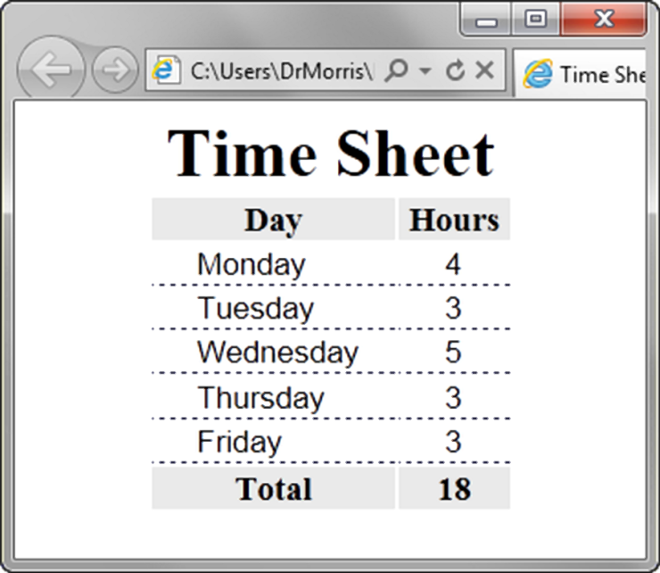
Table Row
Groups
<table> <caption>Time Sheet</caption>
<thead>
<tr>
<th id="day">Day</th>
<th id="hours">Hours</th>
</tr>
</thead>
<tbody>
<tr>
<td headers="day">Monday</td>
<td headers="hours">4</td>
</tr>
…
<tr>
<td headers="day">Friday</td>
<td headers="hours">3</td>
</tr>
</tbody>
<tfoot>
<tr>
<td headers="day">Total</td>
<td headers="hours">18</td>
</tr>
</tfoot> </table>
<thead>
table head rows
<tbody >
table body rows
<tfoot>
table footer rows

Slide 45
Summary
This chapter provided an introduction to HTML.
You will use these skills over and over again as you create web pages.

